Slide 1


Project Proposal: Netflix
Team Bytes Buster:
Landraud Robin 12235243
Lavigne Nicolas 12235239
Akbarjon Matrasulov 12204550
Muminjon Mukhammadov 12214678

Slide 2
Summary
Why did we choose this dataset?
How will we use It?
Some insight
User Survey
Tools
Plan

Slide 3
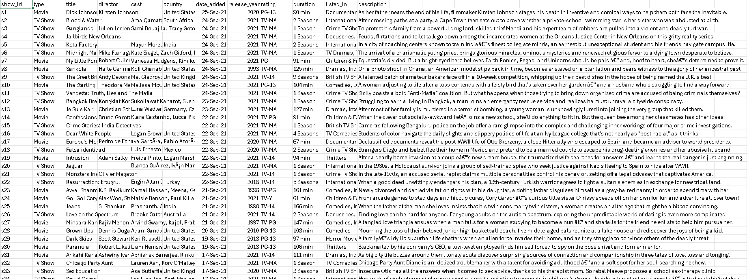
Why did we choose this dataset?
List All Netflix Movie, with their director, date published, duration, rating, cast, type.

Slide 4
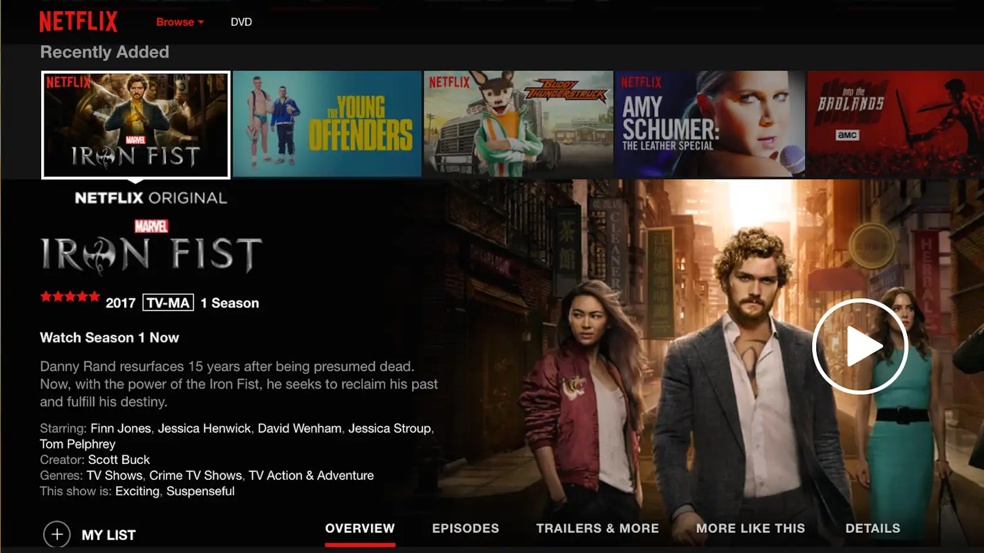
How will we use It?
Want to show some routine and trend of Netflix user.
Extract and sort data on movie rating, to understand what type of movie are like.

Slide 5
Some insight
Impact of the duration of content on audience. For example, we can help to determine what type of movie streaming platform should provide.
What type of movie they should showcase based on the moment of the day (horror Friday night, etc..).
More simply, what kind of movie customer enjoy the most based on rating.

Slide 6
User Survey
1. How often do you use the platform to watch movies?
2. What time of day do you usually watch movies on the platform?
3. How many movies do you typically watch in a week on the platform?
4. Do you prefer watching movies alone or with friends/family on the platform?
5. Which genres of movies do you prefer to watch on the platform? (Select all that apply)
Action
Comedy
Drama
Horror
Science Fiction
Romance
Documentary
Other (please specify)
6. What are your favorites movies titles?
7. How do you usually choose which movie to watch on the platform?
Recommendations from the platform
Personal recommendations from friends/family
Popular or trending movies
Specific actors or directors
Other (please specify)
8. Are there any specific actors or actresses whose movies you always watch on the platform? If yes, please list them.- Do you have any favorite movie directors whose films you always watch on the platform? If yes, please list them.

Slide 7
User Survey
9. How important is the availability of new releases on the platform to you?
Very important
Somewhat important
Not important
10. Do you ever re-watch movies on the platform? If yes, how often?
11. Have you ever participated in any movie-related discussions or forums on the platform?
12. Do you prefer watching movies on the platform's website or mobile app?
13. How satisfied are you with the variety of movies available on the platform? Very satisfied
Somewhat satisfied
Neutral
Somewhat dissatisfied
Very dissatisfied
14. How likely are you to recommend the platform to a friend or family member?
Very likely
Likely
Neutral
Unlikely
Very unlikely
15. In which place do you most often watch content on the platform? (transport, living room, bedroom, in garden, ...)
Notes:
With the survey we understand that taste are realy different from one profile to an other. We we can also find some similarity

Slide 8



Tools
To sorted, filtred, extract useful data.
To create some graph and create some statistics.
To extract some insight, get useful analysis based on specifics provide promps.

Slide 9
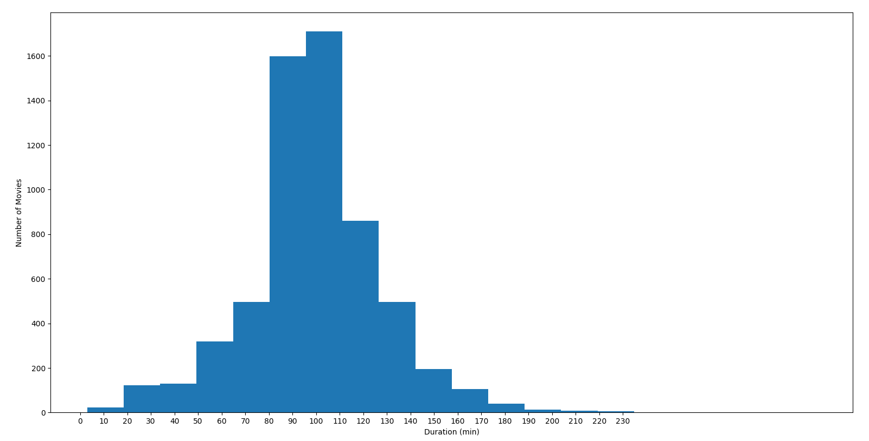
Plan
Brainstorm and make proposal.
Analyse survey.
Analyse Data set.
Extract Key data and insight.
List and present result in doc and with a PPT.

Slide 10
Conclusion
In conclusion, our proposed project focuses on leveraging big data analysis on Netflix datasets to glean valuable insights into user preferences and viewing trends. By selecting this dataset, we aim to comprehensively explore various aspects of Netflix content, including movie details such as directors, publication dates, durations, ratings, casts, and genres.
Key areas of investigation include the impact of content duration on audience engagement, optimal movie genres for different times of the day, and identifying the most popular movie types based on user ratings. By presenting our findings through comprehensive documentation and presentations, we aim to provide actionable insights for streaming platforms to enhance their content offerings and improve user satisfaction.
Overall, our project aims to uncover valuable insights that can inform strategic decision-making in the entertainment industry, ultimately enhancing the user experience and driving platform success.

